Slide 1
Chess AI using Alpha-Beta Pruning
By :
Samarth S Hadimani (181IT240) Mob No-9538450305
Sunil Kumar (181IT148)-6387412467
Narendra (181IT229)-8747956098
Vara Prasad (181IT122)-9945320666
Tanmaiyh Tentu (181IT249)-9880609222

Slide 2
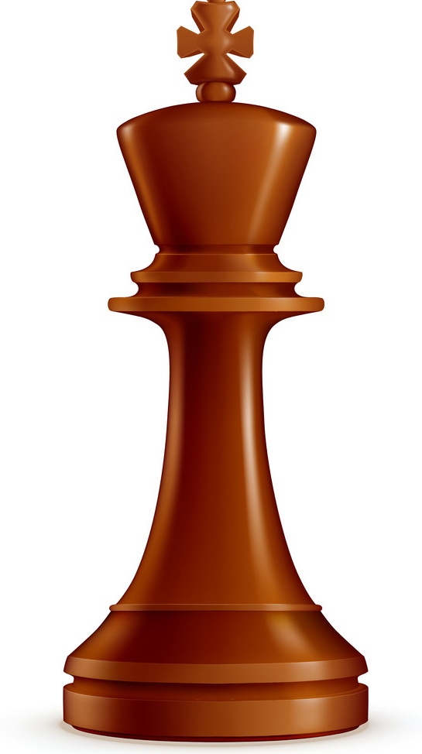
Introduction
Backtracking is a technique based on algorithm to solve problem.It uses recursive calling to find the solution by building a solution step by step increasing values with time. It removes the solutions that doesn't give rise to the solution of the problem based on the constraints given to solve the problem.
Backtracking algorithm is applied to some specific types of problems,
Decision problem used to find a feasible solution of the problem.
Optimisation problem used to find the best solution that can be applied.
Enumeration problem used to find the set of all feasible solutions of the problem.

Slide 3
Significance of Backtracking
Backtracking algorithms finds it’s applications in a variety of gaming puzzles and hence form an interesting class of methodologies to determine all possible intermediate moves in a particular puzzle thereby evolving unique ways of deciding the result of the game/puzzle which could be a victory,loss or a tie.
Understanding the underlying intuition behind the combinations of moves is therefore necessary in designing games and further help optimize these games in terms of time-based efficiency when one of the players in the games involve computer itself .
Mini-max algorithm is a recursive or backtracking algorithm which is used in decision-making and game theory. It provides an optimal move for the player assuming that opponent is also playing optimally.

Slide 4
Minimax Algorithm
Mini-max algorithm is a recursive or backtracking algorithm which is used in decision-making and game theory. It provides an optimal move for the player assuming that opponent is also playing optimally.
Mini-Max algorithm uses recursion to search through the game-tree.
In this algorithm two players play the game, one is called MAX and other is called MIN.
Both the players fight it as the opponent player gets the minimum benefit while they get the maximum benefit.
Both Players of the game are opponent of each other, where MAX will select the maximized value and MIN will select the minimized value.
The minimax algorithm performs a depth-first search algorithm for the exploration of the complete game tree.
The minimax algorithm proceeds all the way down to the terminal node of the tree, then backtrack the tree as the recursion.

Slide 5
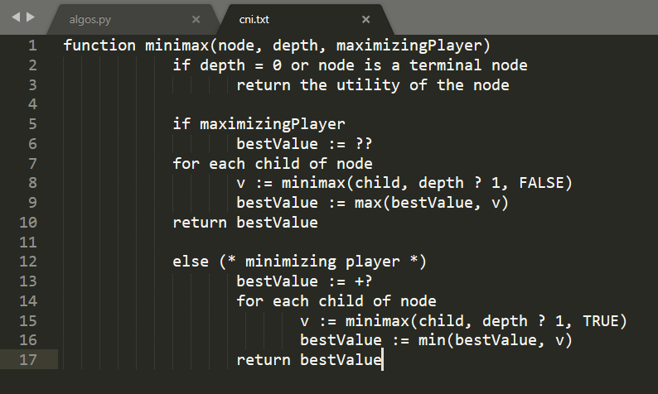
Pseudo-Code for Mini-Max algorithm

Slide 6
MAX
4
MIN
-3
4
min
min
MAX
-3
7
4
5
Terminal state
Max
Max
Max
Max
-3
-5
0
7
-1
4
2
5

Slide 7
Alpha - Beta Pruning
Alpha-beta pruning is a modified version of the minimax algorithm. It is an optimization technique for the minimax algorithm.
There is a technique by which without checking each node of the game tree we can compute the correct minimax decision, and this technique is called pruning.
Alpha-beta pruning can be applied at any depth of a tree, and sometimes it not only prune the tree leaves but also entire sub-tree.
The two-parameter can be defined as:
Alpha: The best (highest-value) choice we have found so far at any point along the path of Maximizer. The initial value of alpha is -∞.
Beta: The best (lowest-value) choice we have found so far at any point along the path of Minimizer. The initial value of beta is +∞.
The Alpha-beta pruning to a standard minimax algorithm returns the same move as the standard algorithm does, but it removes all the nodes which are not really affecting the final decision but making algorithm slow. Hence by pruning these nodes, it makes the algorithm fast.

Slide 8
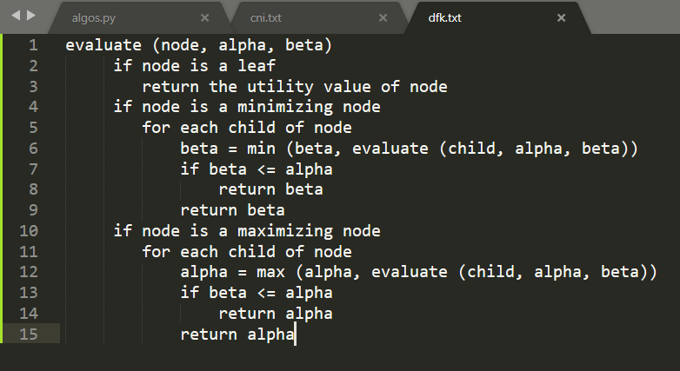
Pseudo-Code for Alpha-Beta Pruning

Slide 9
α=
MAX
4
4
MIN
β=
-3
β=
4
MAX
α=
2
α=
-3
α =
-1
4
5
Terminal state
-3
-5
0
7
-1
4
2
5

Slide 10

Modules
smarter AI:
move-ordering
faster move-generation
end-game evaluation
state-caching
opening book
GUI:
log message
promotion
move highlight
win condition

Slide 11
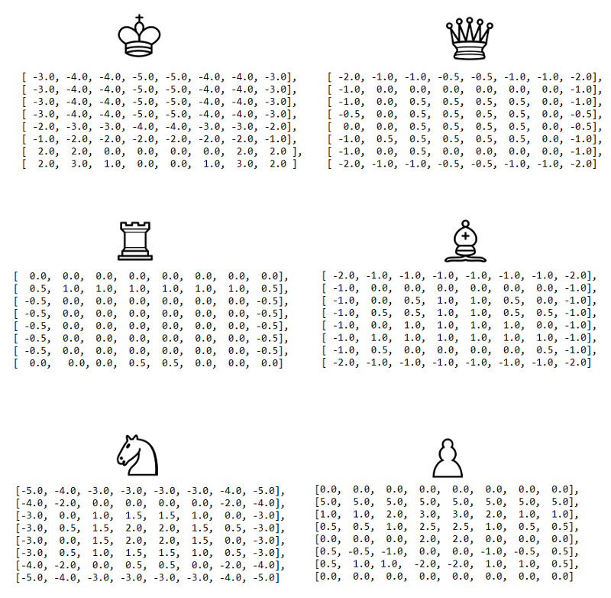
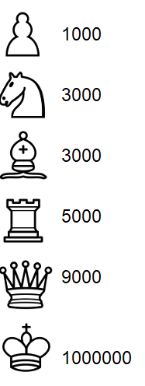
Piece and piece- square values
Score = piece.value + piecetable.value[x,y]
For each piece have with respect to the position in tha board has a value i.e is score
Initially score for white pieces is -ve and it tries to maximise its score and for blacks the value is +ve and they try to minimise it.

Slide 12
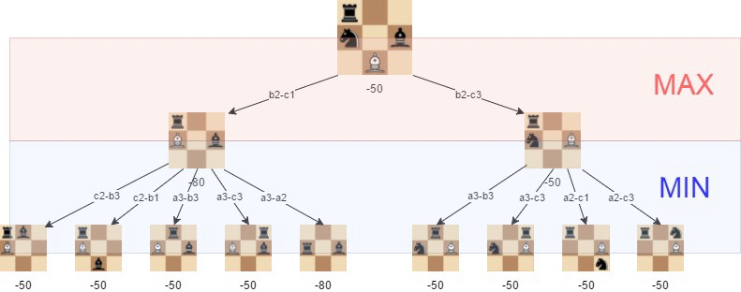

Slide 13
Analysis
The effectiveness of alpha-beta pruning is highly dependent on the order in which each node is examined. Move order is an important aspect of alpha-beta pruning.
It can be of two types:
Worst ordering: In some cases, alpha-beta pruning algorithm does not prune any of the leaves of the tree, and works exactly as minimax algorithm. In this case, it also consumes more time because of alpha-beta factors, such a move of pruning is called worst ordering. In this case, the best move occurs on the right side of the tree. The time complexity for such an order is O(b^{m}).
Ideal ordering: The ideal ordering for alpha-beta pruning occurs when lots of pruning happens in the tree, and best moves occur at the left side of the tree. We apply DFS hence it first search left of the tree and go deep twice as minimax algorithm in the same amount of time. Complexity in ideal ordering is O(b^{m/2}).

Slide 14
Conclusion
Alpha Beta Pruning is all about reducing the size (pruning) of our search tree. While a brute-force approach is an easier approach to use, it doesn’t necessarily mean it is the most optimal approach. Many times, one doesn’t need to visit all possible branches to come up with the best possible solution in hand.
The minimax algorithm may not be the best solution to all kinds of computer games that need to have AI.But given a good implementation, it can create a tough competitor.

